Slide 1

Microsoft 365 platform community call
aka.ms/m365pnp
Your host in this call: Vesa Juvonen
June 28, 2022
Notice! Last call before summer break between 1st of July and 31st of August

Slide 2
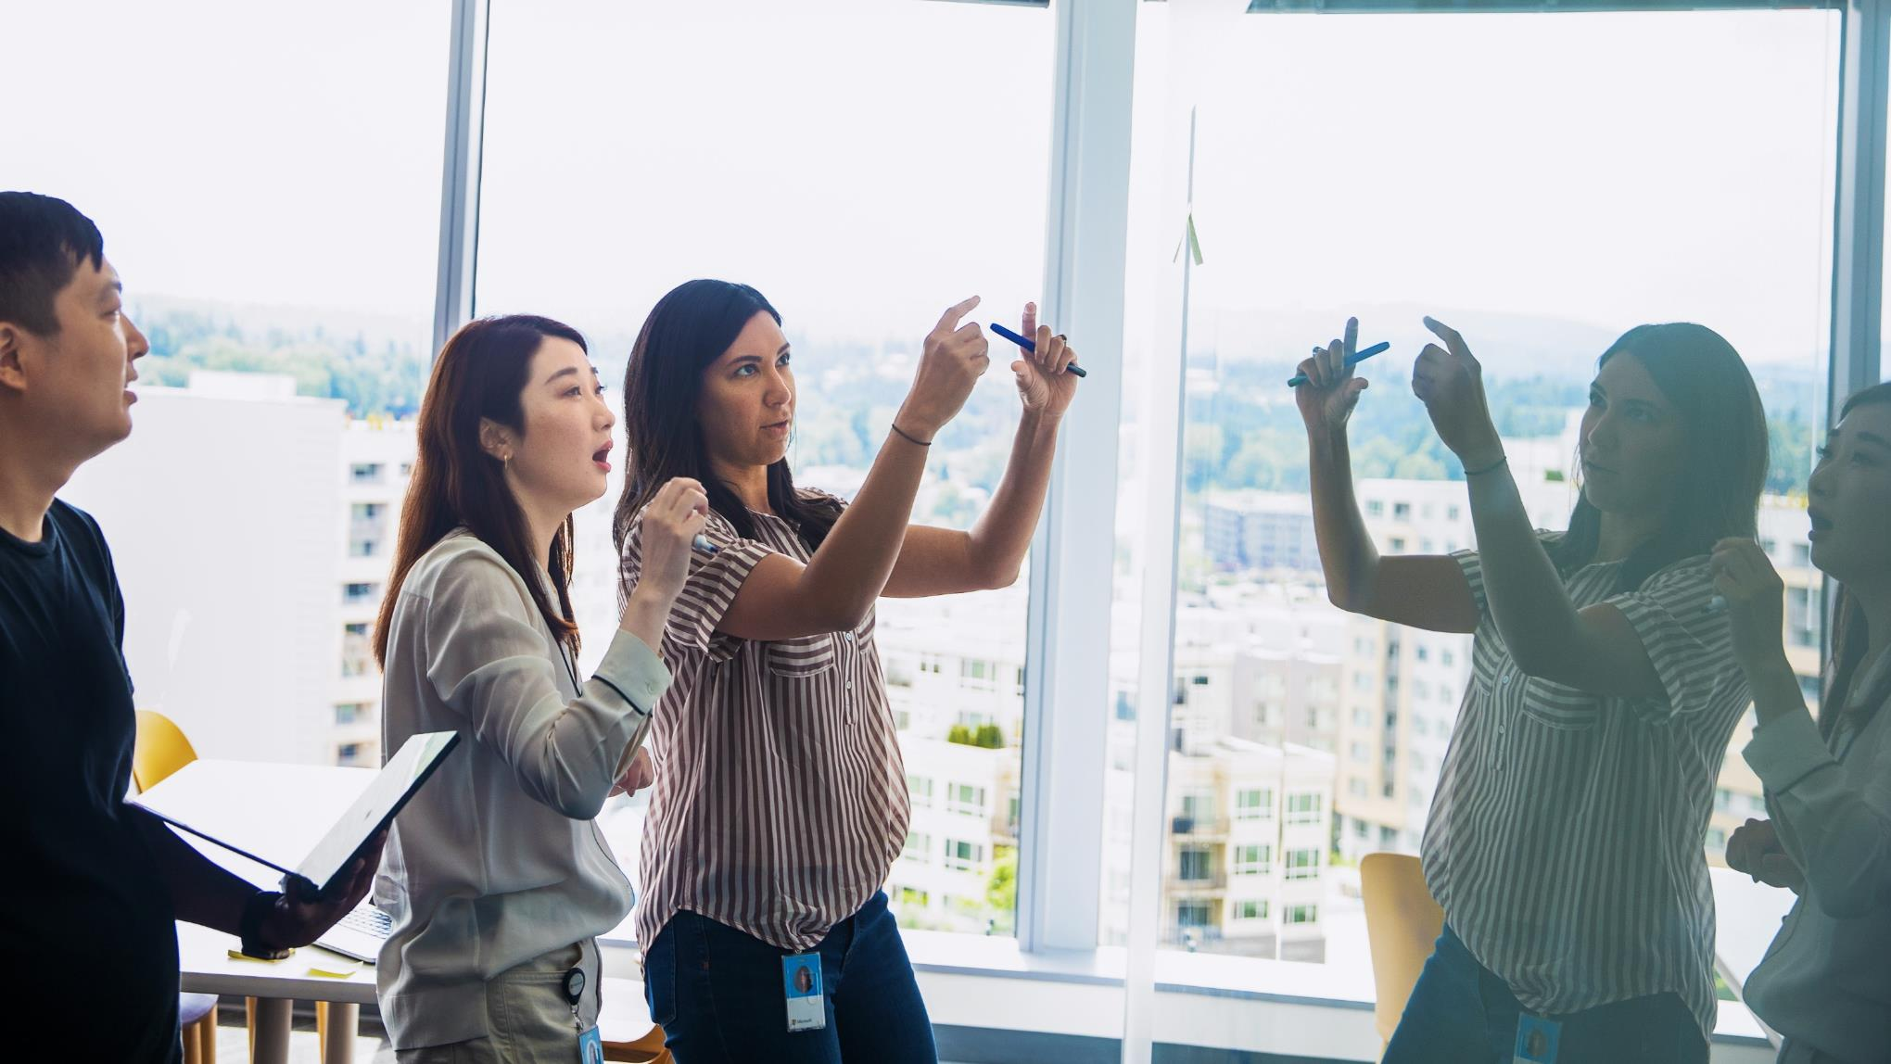
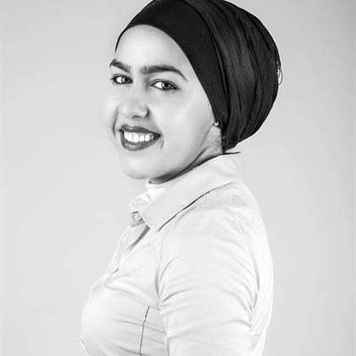



Agenda
Latest updates and news on the Microsoft 365 platform
Group picture time with Together Mode!
Demos
Rabeb Othmani - Taking advantage of the Microsoft Graph Postman collections
Divyanka Malik & Geeta Ramakrishnan - Introduction on the Microsoft Viva Learning extensibility
Benjamin Olson - Introduction to Virtual Appointment API
Notice! Last call before summer break between 1st of July and 31st of August

Slide 3
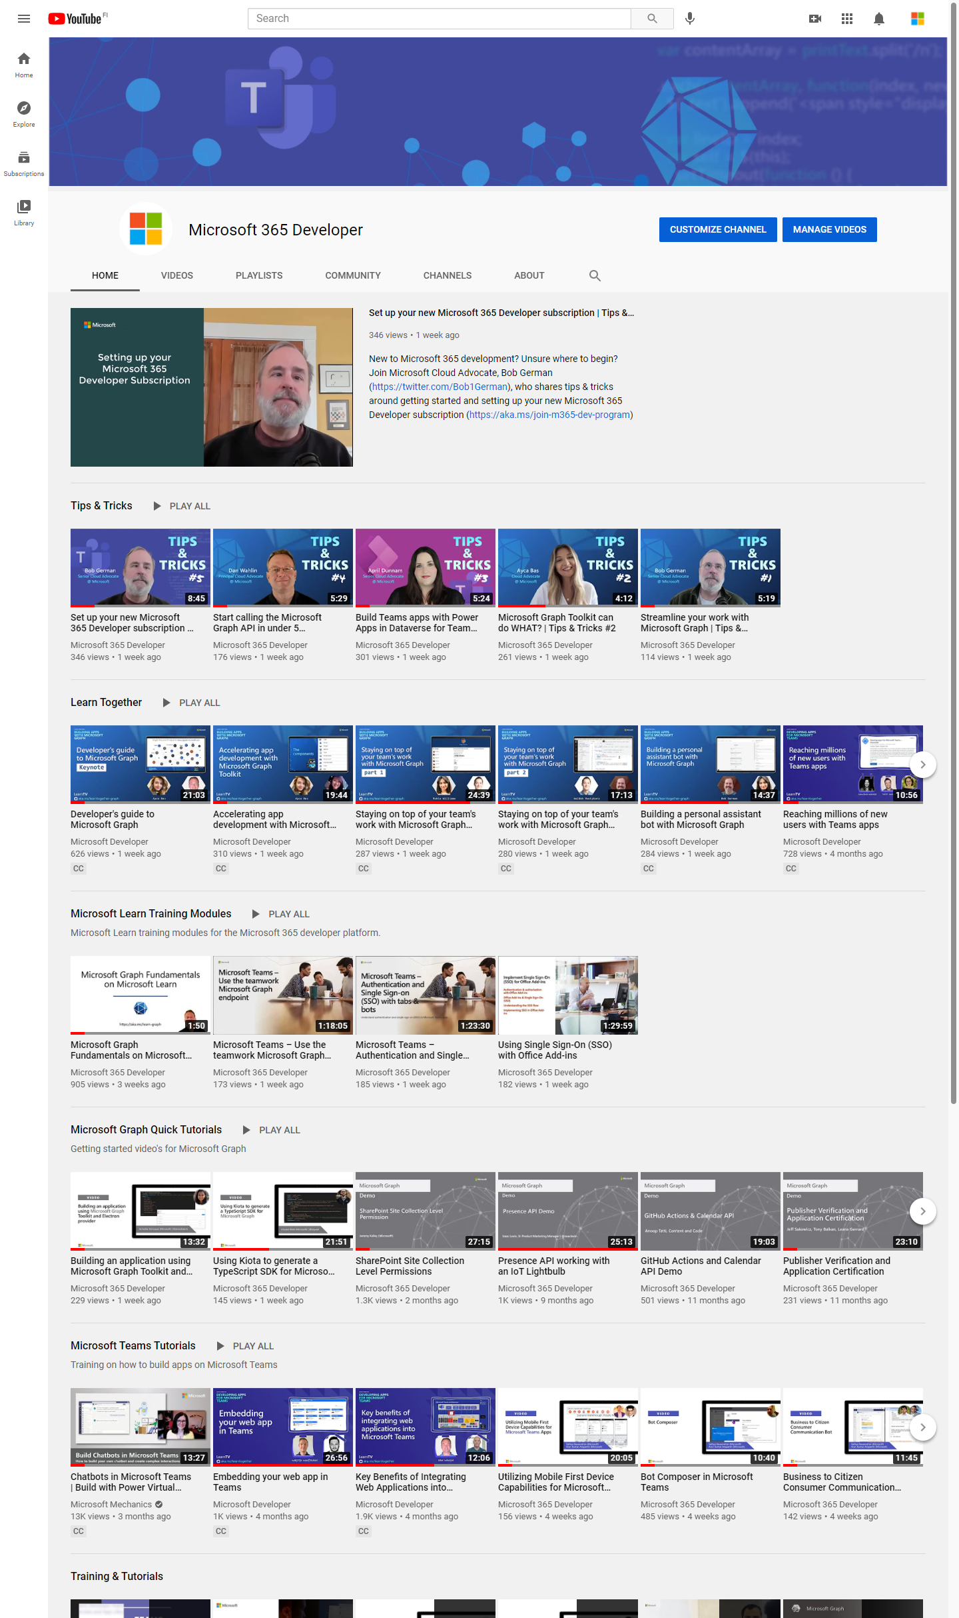
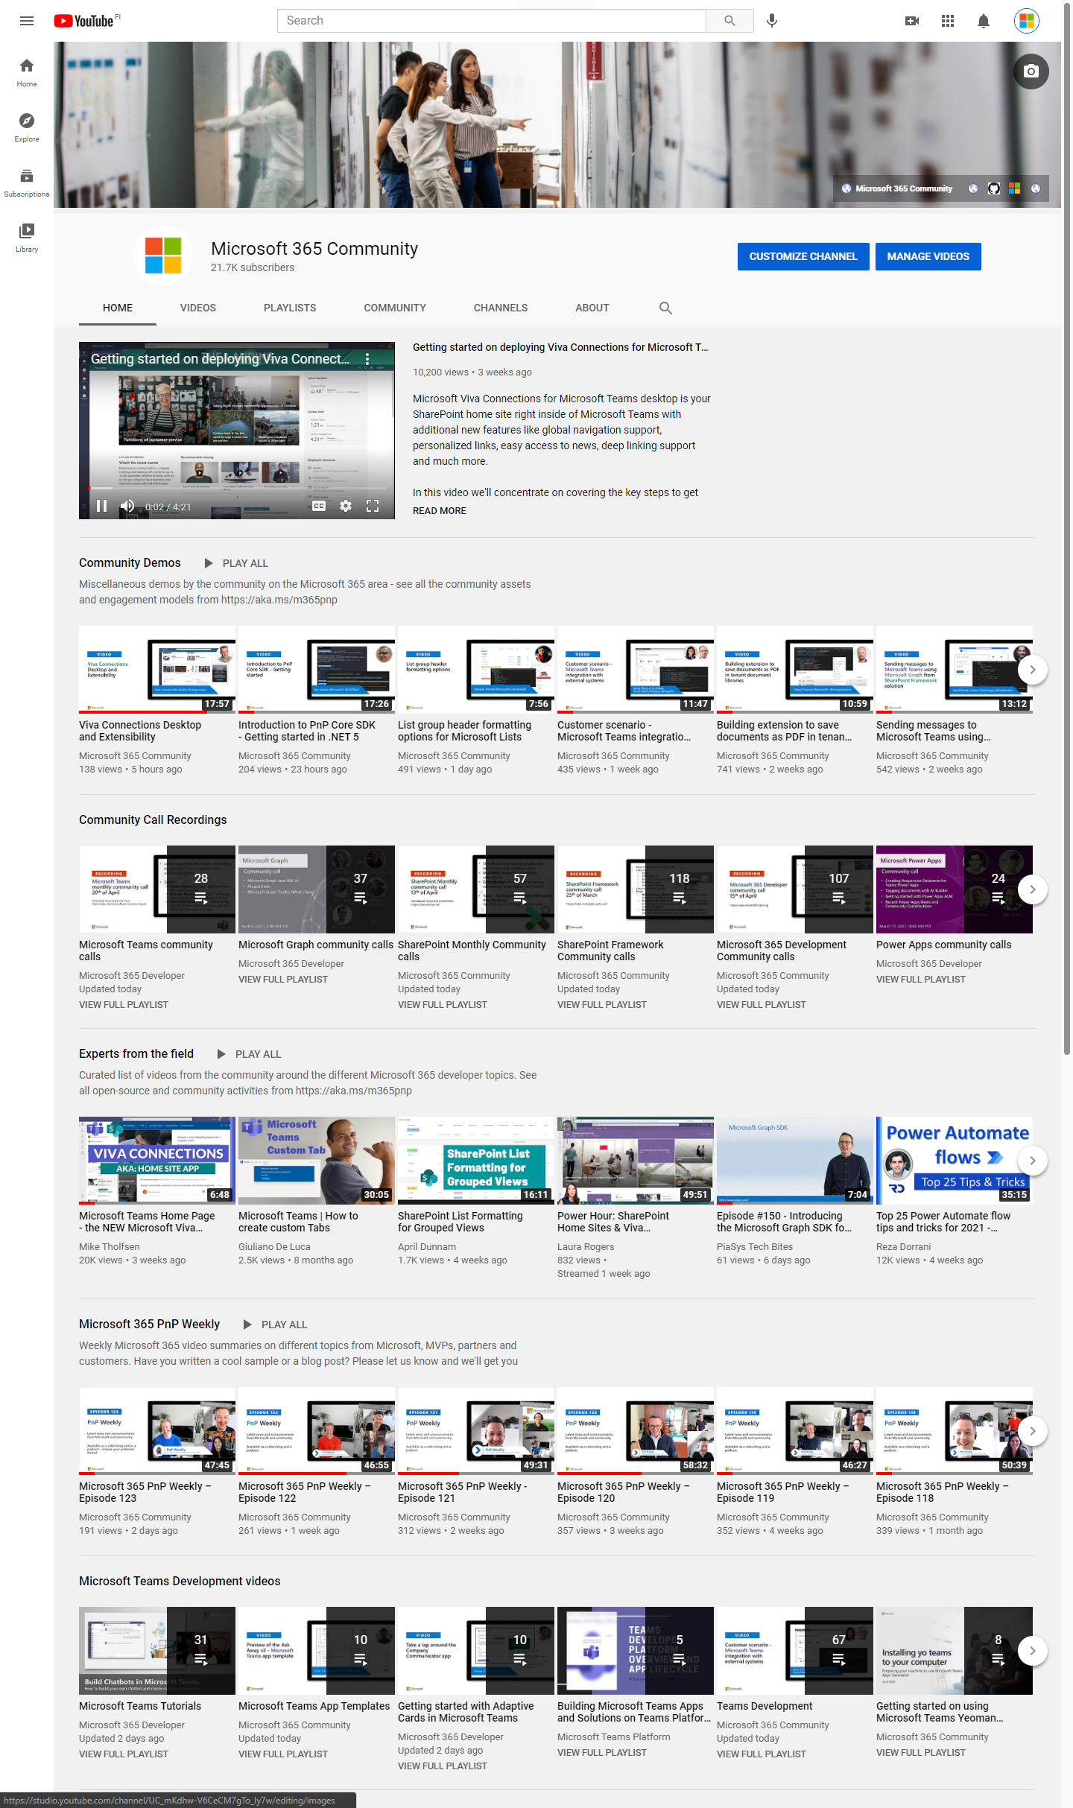
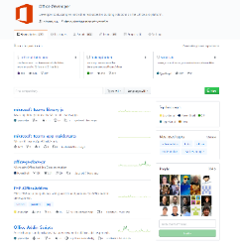
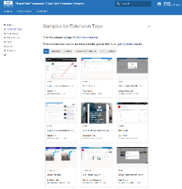
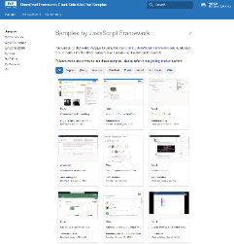
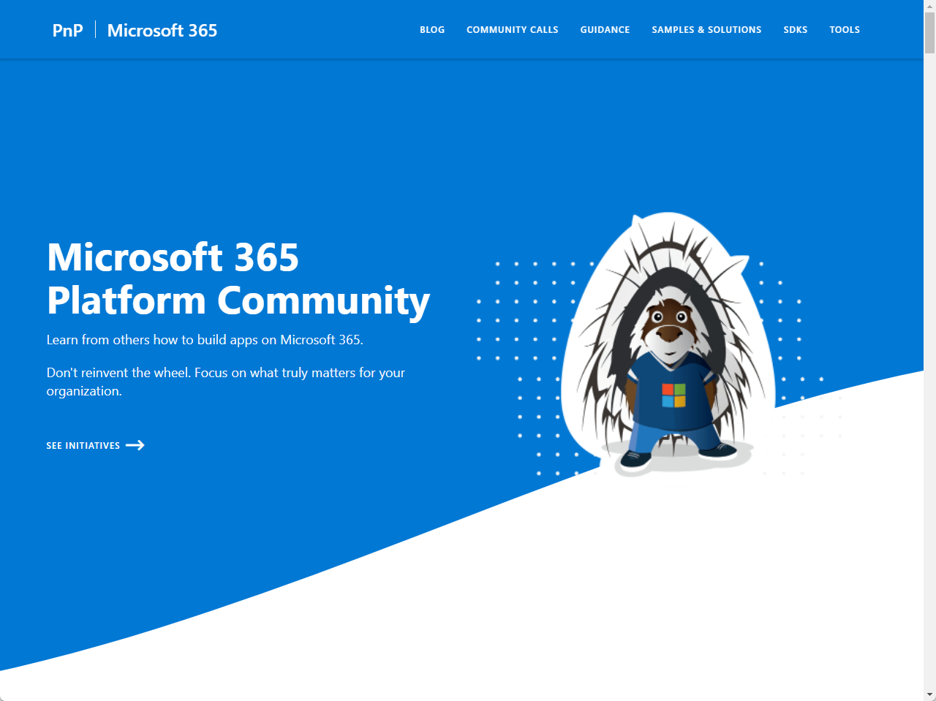
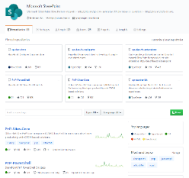
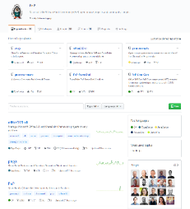
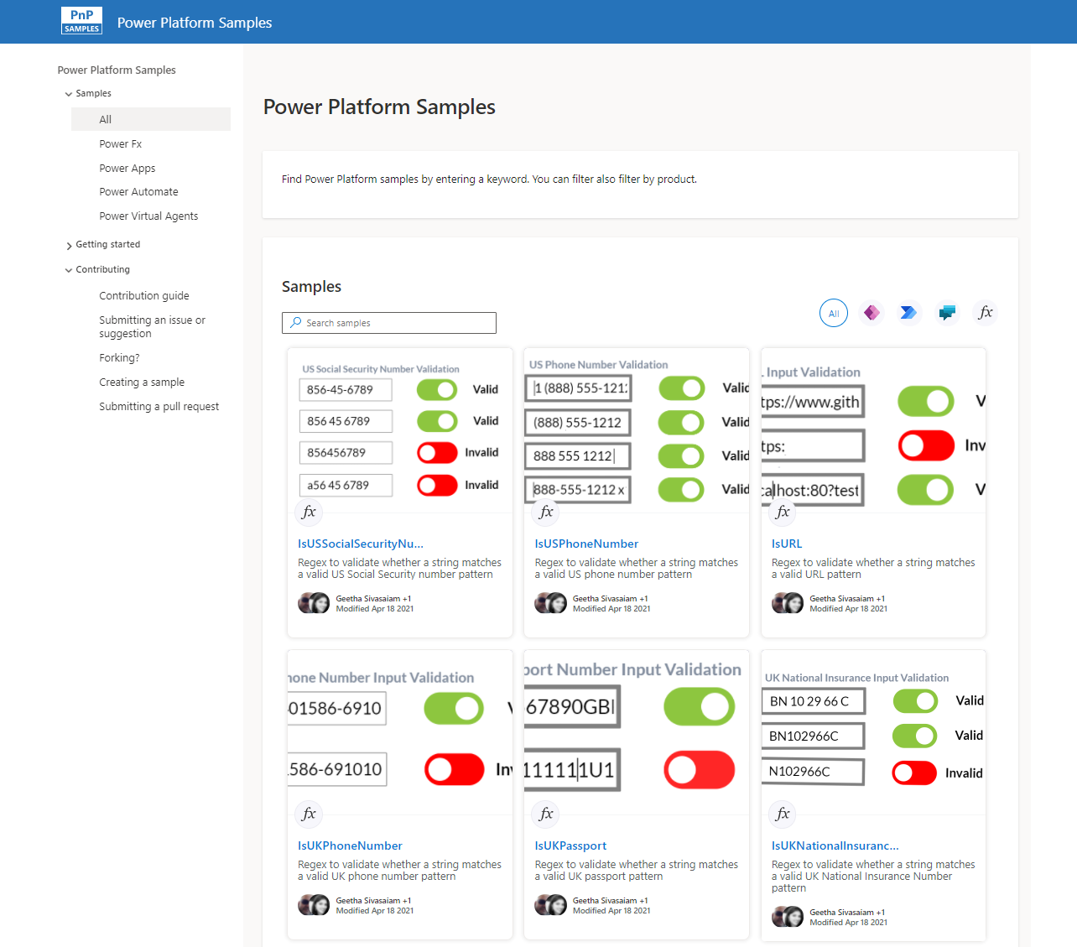
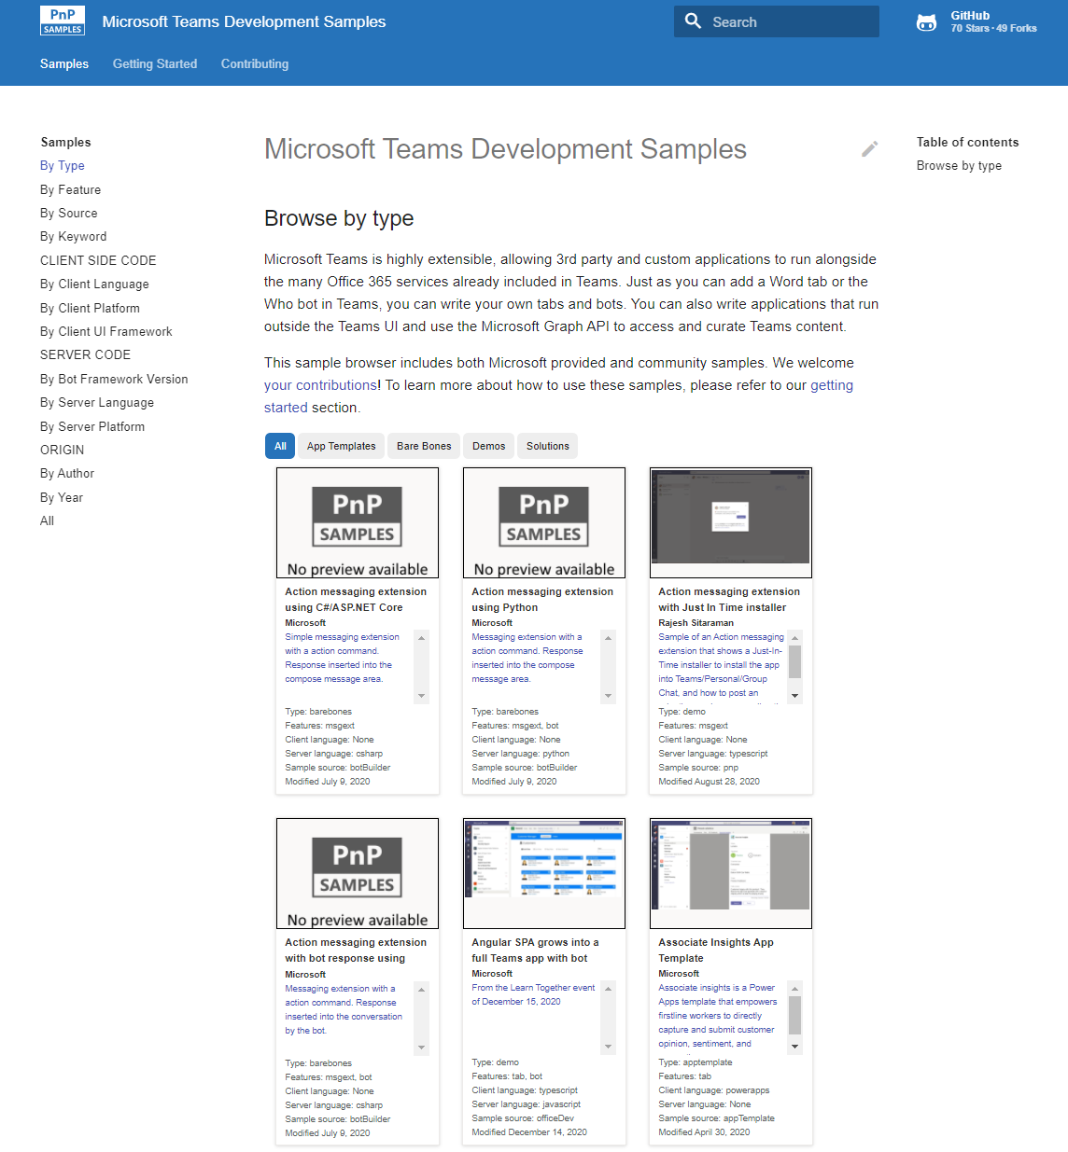
Microsoft 365 developer videos
Microsoft 365 community videos
Open-source
Sample galleries
Open-source initiatives and samples
aka.ms/m365devyoutube
aka.ms/m365/videos
github.com/pnp
github.com/officedev
github.com/sharepoint
github.com/microsoftgraph
aka.ms/m365/samples
aka.ms/teams-samples
aka.ms/spfx-webparts
aka.ms/powerplatform-samples
aka.ms/spfx-extensions
aka.ms/list-formatting
aka.ms/m365/community
@Microsoft365Dev | @m365pnp

Slide 4
Microsoft 365 developer community calls
Microsoft 365 platform (weekly) https://aka.ms/m365-dev-call
(Notice. This call is on a summer break between July 1st and 31st of August 2022)
Adaptive Cards https://aka.ms/adaptivecardscommunitycall
Microsoft identity platform https://aka.ms/IDDevCommunityCalendar
Office Add-ins https://aka.ms/officeaddinscommunitycall
Power Platform https://aka.ms/PowerAppsMonthlyCall
Microsoft 365 and Power Platform community (bi-weekly) https://aka.ms/m365-dev-sig
Viva Connections & SharePoint Framework (bi-weekly) https://aka.ms/spfx-call
Download recurrent invites from
https://aka.ms/m365/calls
Notes:
m365-dev-sig

Slide 5
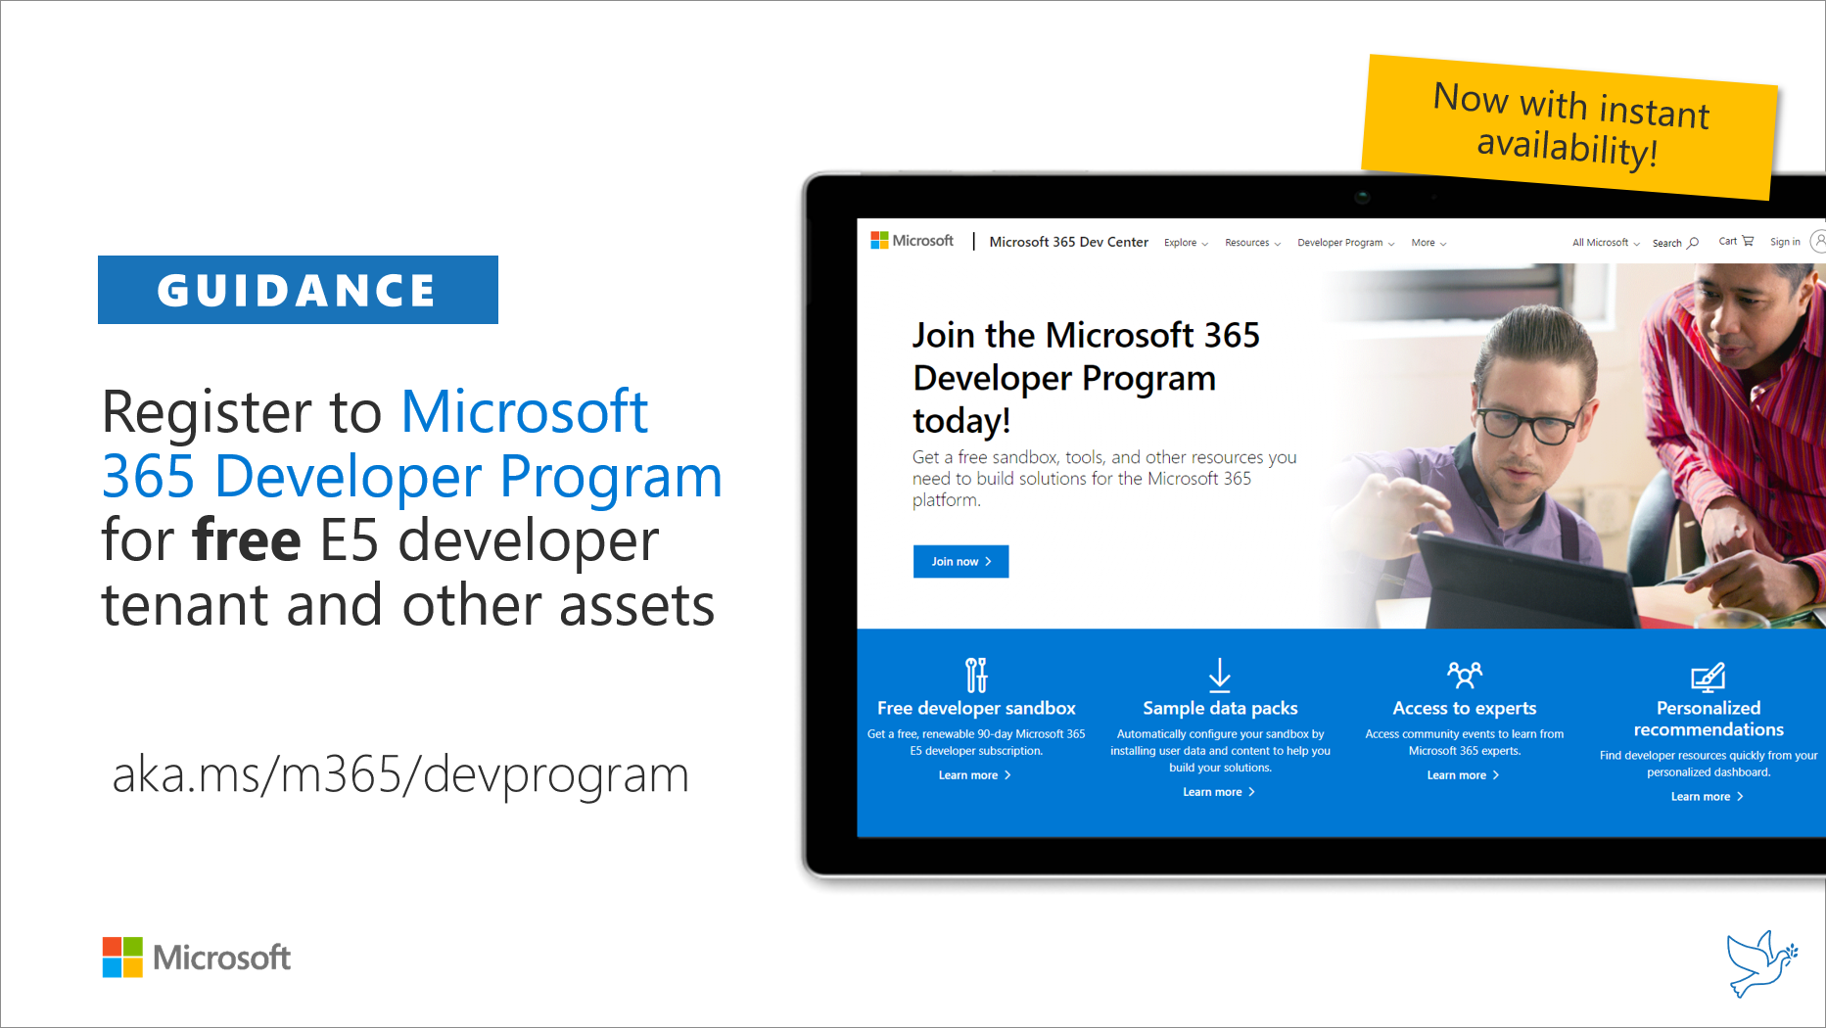
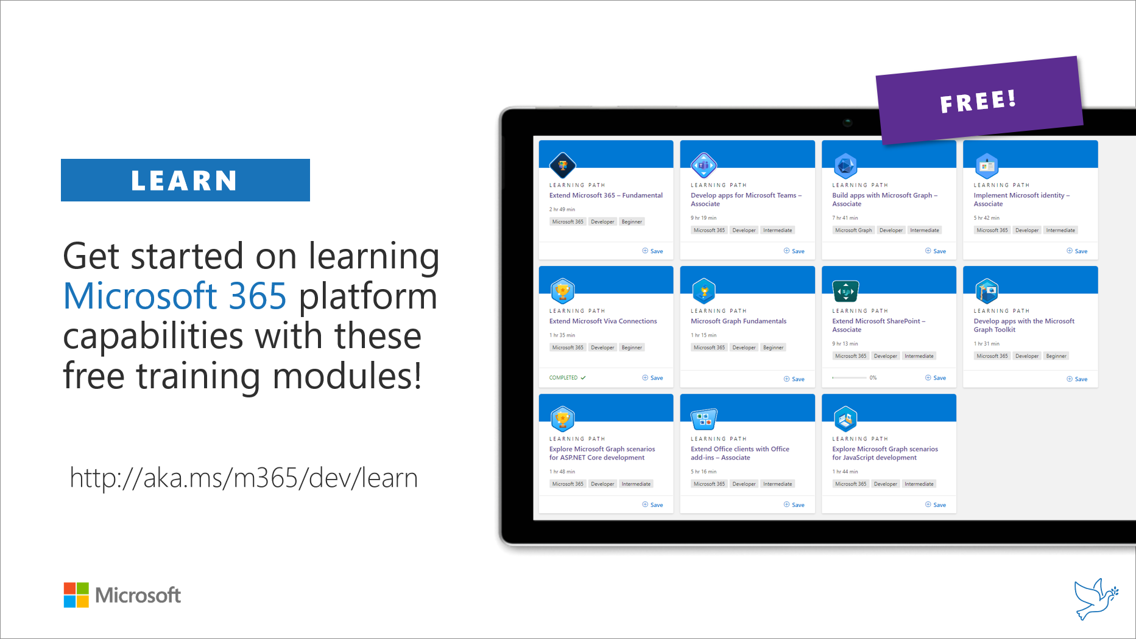
Getting started assets for Microsoft 365 dev
aka.ms/m365/devprogram
aka.ms/m365/dev/learn

Slide 6
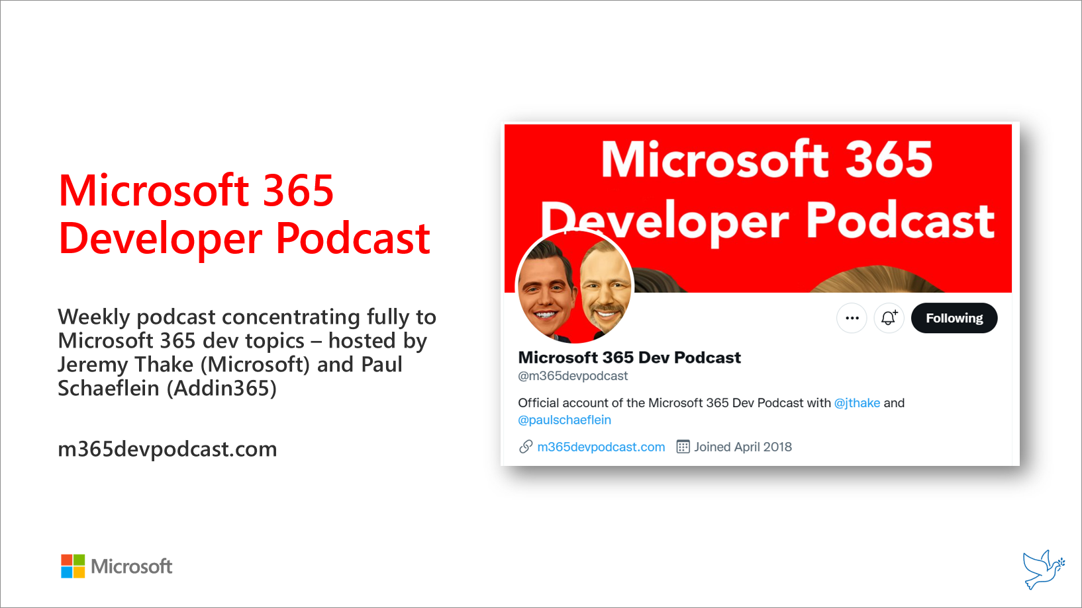
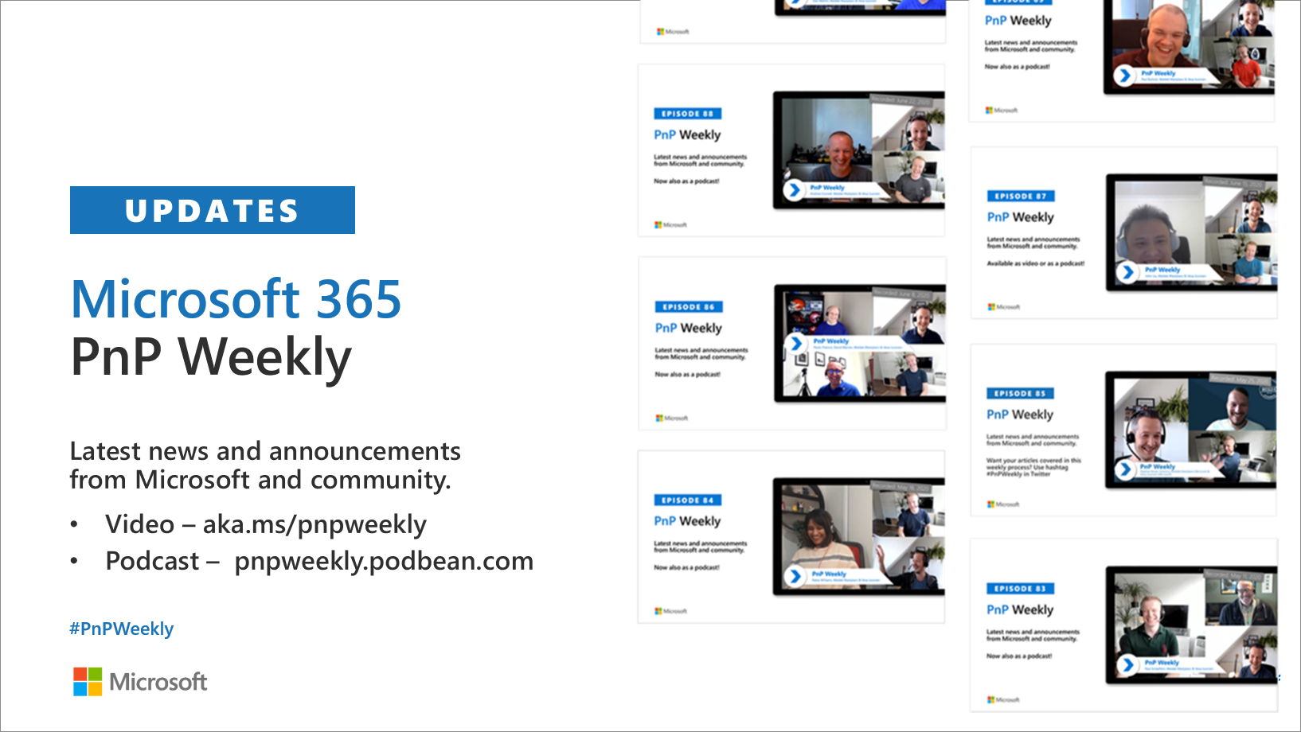
Microsoft 365 Developer podcasts
m365devpodcast.com
Video – aka.ms/pnpweekly
Podcast – pnpweekly.podbean.com

Slide 7
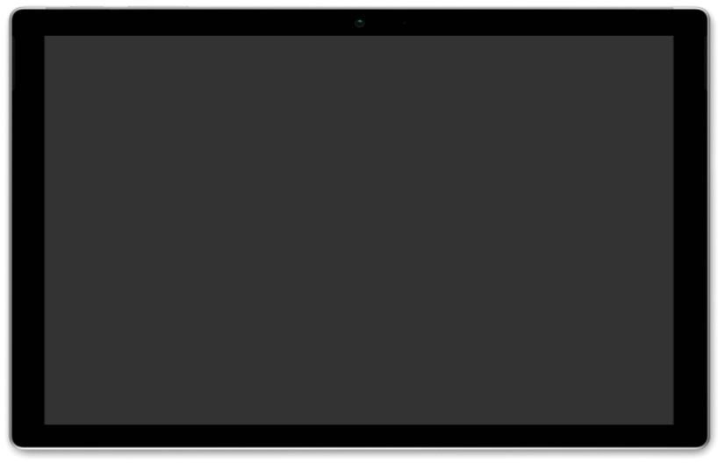
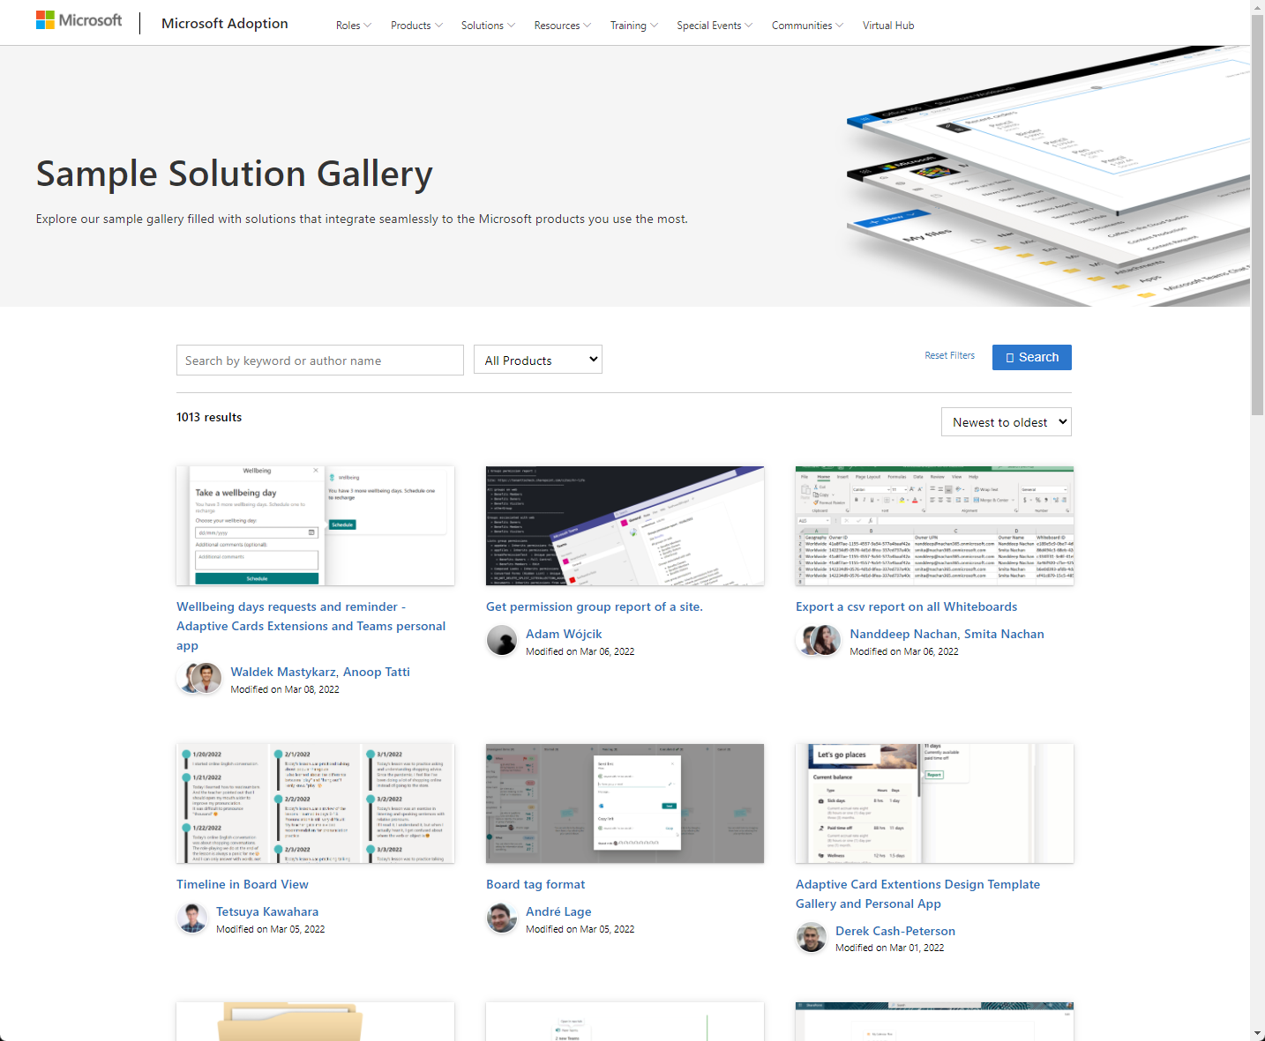
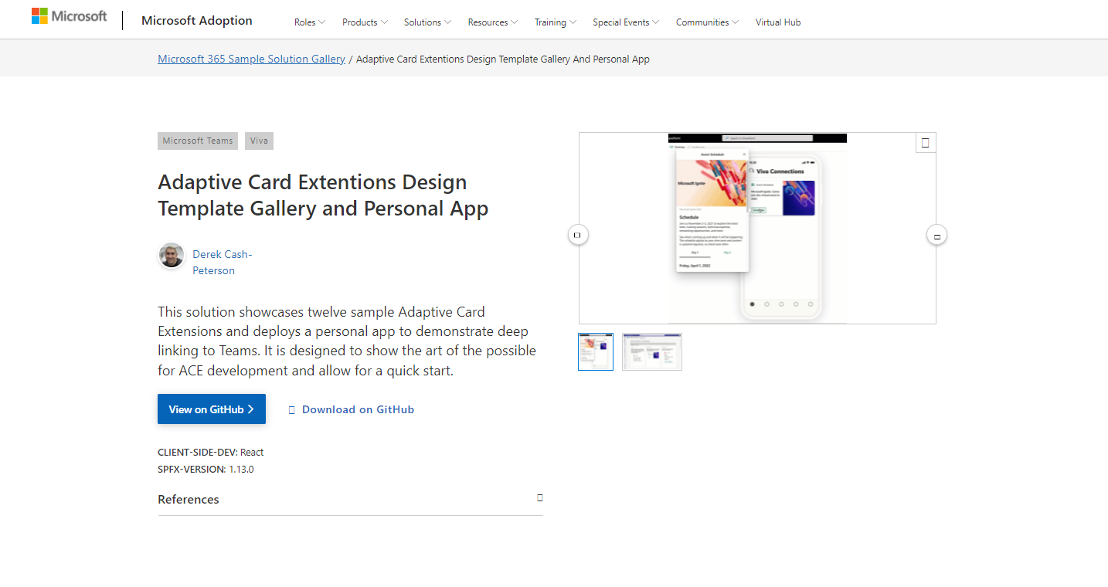
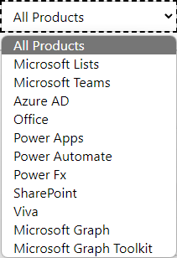

SAMPLES
New Microsoft 365 sample gallery with more than 500 samples from Microsoft and community
1100
aka.ms/m365/samples

Slide 8
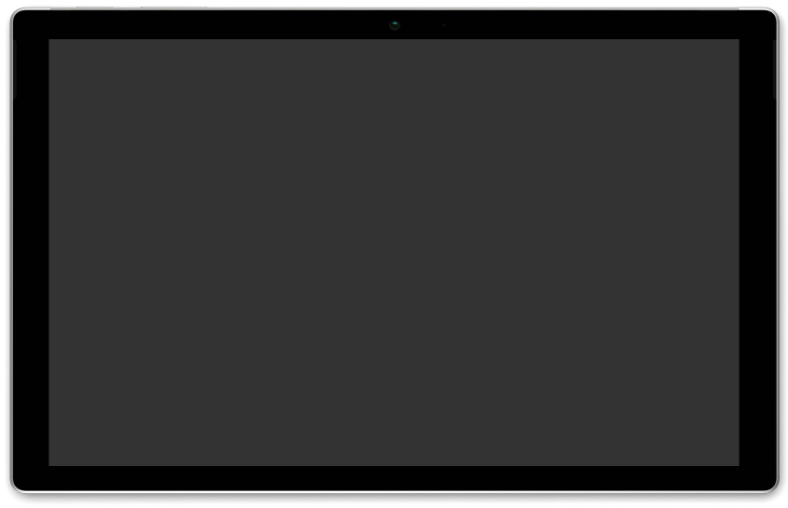
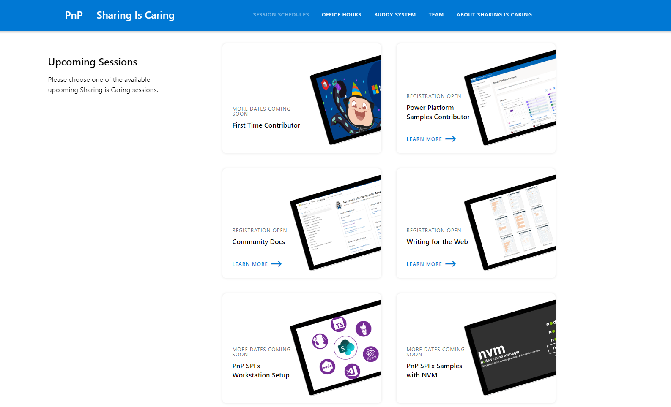
GUIDANCE
Learn how to get started in the open-source PnP community!
Upcoming Sessions:
General First Time Contributor
Power Platform Samples Contributor
SPFx Developer Workstation Setup
Using PnP SPFx samples w/ NVM
More than code with VS Code
First-time presenter
M365 Maturity Model Practitioners
Writing for the Web
Power Platform - Power Pages – Coming Soon!!!
New Date: JULY
https://aka.ms/sharing-is-caring
Notes:
25 Total attendees, 16 attendees who attended both First-Time Contributors and Community Docs sessions.

Slide 9
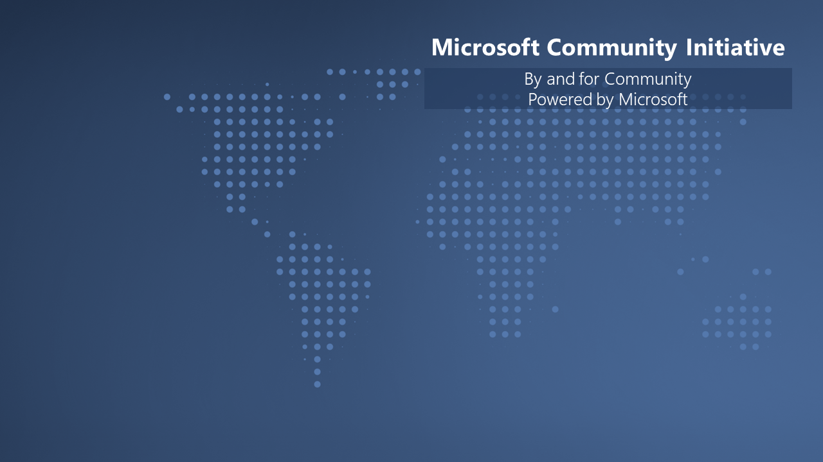

We are building unified Microsoft Cloud Community model with Microsoft 365 and Azure. We are looking for community members to the Community Advisory Board.
Submit at https://aka.ms/MCABLeaderApp

Slide 10

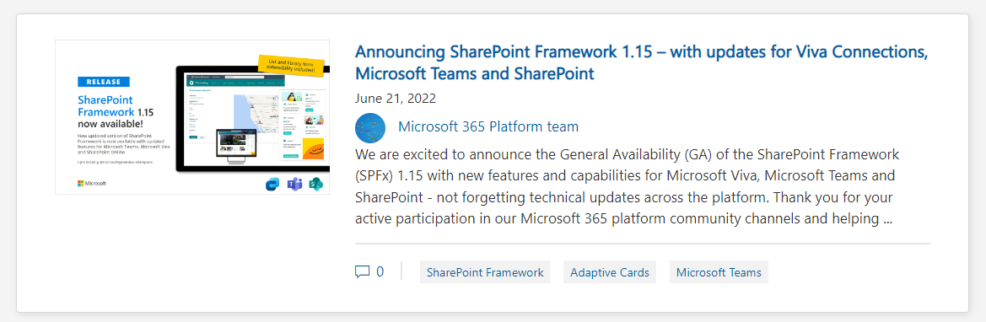
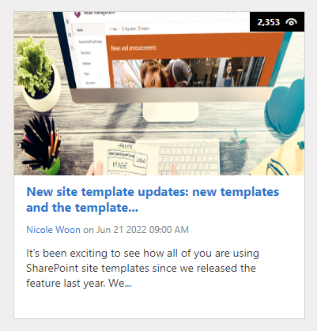
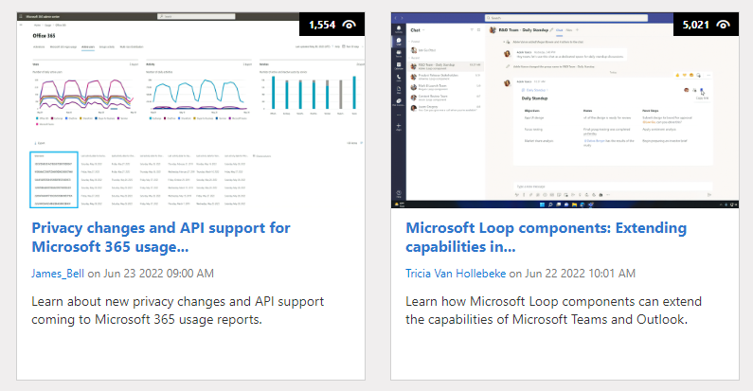
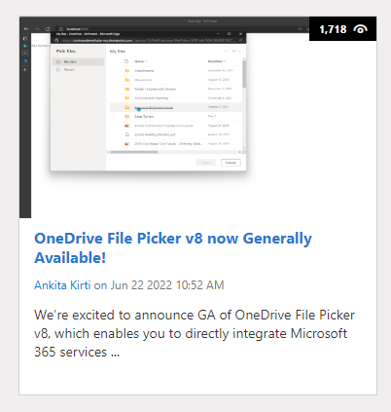
https://aka.ms/m365dev/blog
https://aka.ms/teams/blog
https://aka.ms/microsoftviva/blog
https://aka.ms/sp-blog
Microsoft 365 dev blog
SharePoint Blog
Microsoft 365 Blog
Microsoft 365 Blog
OneDrive Blog
Notes:
SPFx – form customizer and node.js – and more
Templates – three new templates out of the box for communication sites and team sites – Can be also applied on top of the existing sites
Privacy changes and API support – through Graph – obfuscation of data
Loop components – update on the latest status
OneDrive File Picker v8 – Easily pick files from the Microsoft 365 in your solutions – Easy integration option for you custom app

Slide 11
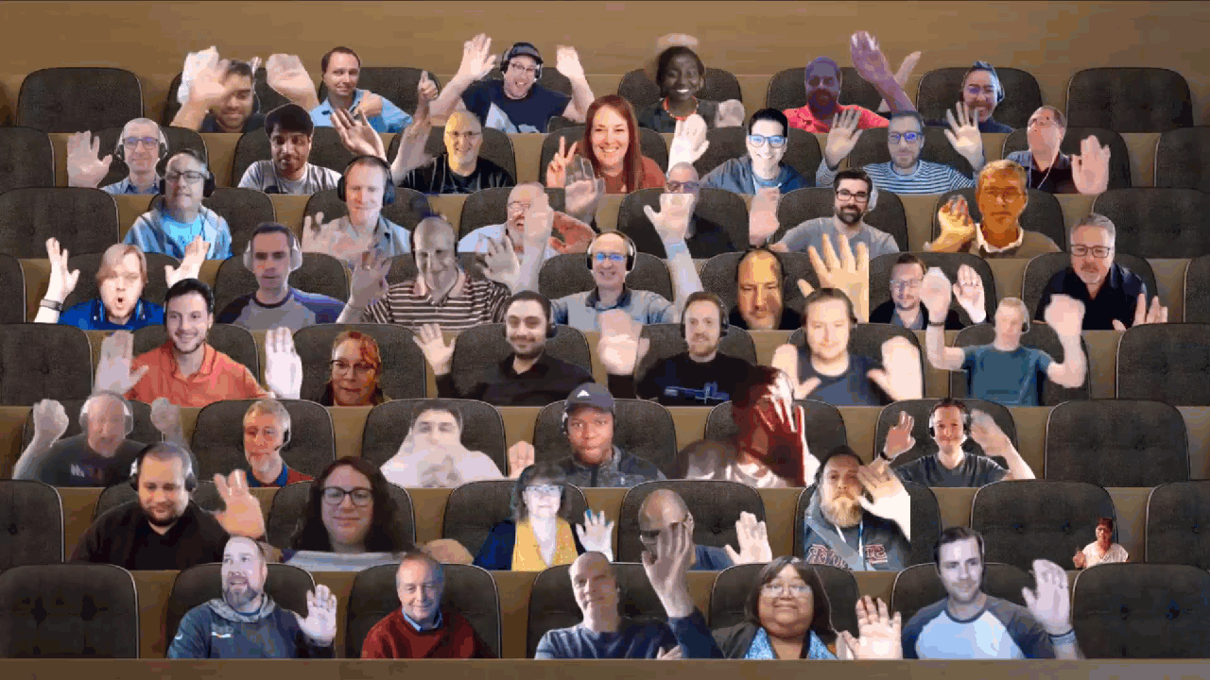

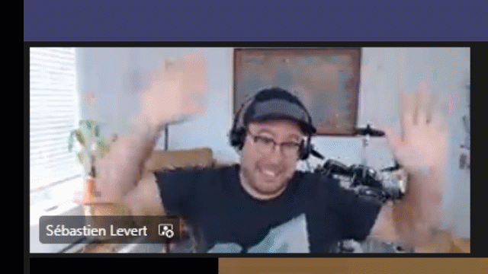
Optional picture time!
Video on and we’ll grab a Together Mode pic with those who are willing to do this.
We are together on this as a community!
Let’s all be like Seb
By enabling your camera for the picture, you grant us permission to share your picture in social media.

Slide 12

DEMO
Taking advantage of the Microsoft Graph Postman collections – Rabeb Othmani
Introduction on the Microsoft Viva Learning extensibility – Divyanka Malik
– Geeta Ramakrishnan
Introduction to Virtual Appointment Microsoft Graph API – Ben Olson

Slide 13
Thank you
Recording will be available in 24 hours on
Microsoft 365 Community (PnP) YouTube channel
https://aka.ms/M365PnP/videos
(subscribe today)
Follow us on Twitter
@Microsoft365Dev | @M365PnP
Next Microsoft 365 Platform call: September 6th at 08:00 am PT
All available community calls from https://aka.ms/m365/calls
(Notice. This call is on a summer break between July 1st and 31st of August 2022)

Slide 14
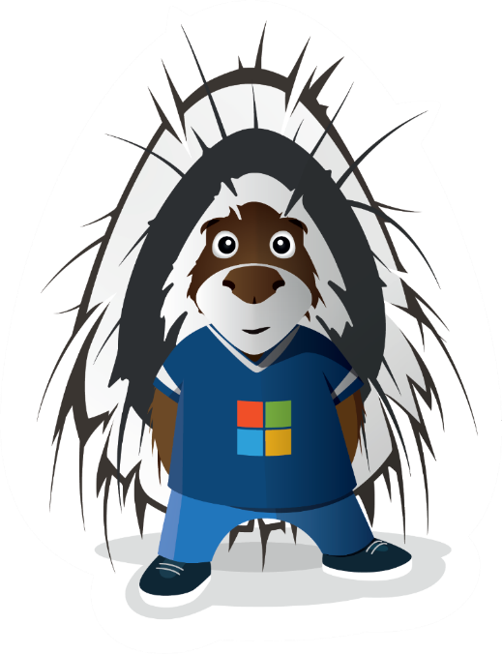


aka.ms/m365pnp

